Slide 1
Mini Project #1:
Sydney Symphony Orchestra composer diversity over the 2018-2020 seasons
by: Emily Young
12 October 2019

Slide 2
Question:
What has been the Sydney Symphony Orchestra’s trend in composer diversity over the 2018-2020 seasons?
Specifically, diversity of programmed works according to:
Composer gender
Composer nationality
1

Slide 3
Why ask this question?
Anecdotally, SSO concerts seem to be heavy on Beethoven, Brahms, Mozart and other composers of the established Western European classical canon
Less programming of newer works
Less diversity in programming = less potential to attract a more diverse and younger audience
1

Slide 4
Hypothesis:
At least 70-75% of the Sydney Symphony Orchestra’s repertoire will consist of works by deceased, male composers of the established European classical music canon (Bach, Beethoven, Brahms, Mozart, etc).
1

Slide 5
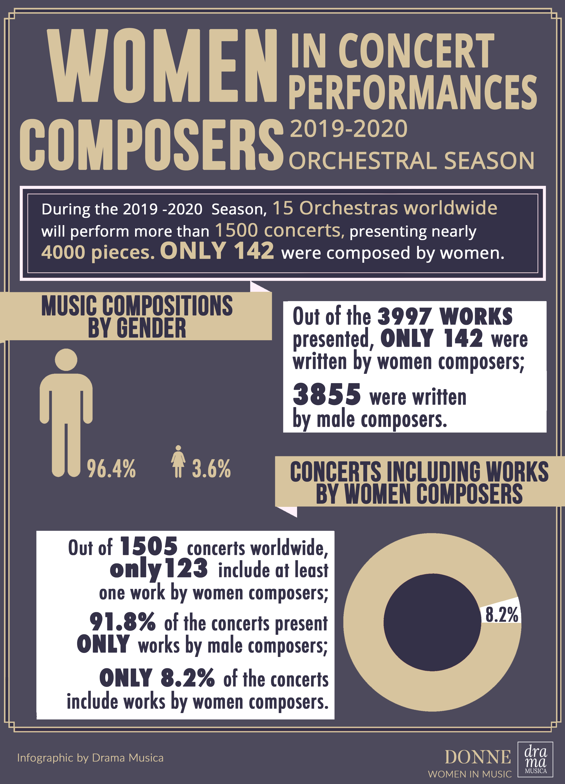
Comparison: 2018-2019 Global Symphony Orchestra Stats – Composer Gender
1
Credit: http://www.drama-musica.com/stories/2019_2020_orchestra_seasons.html

Slide 6
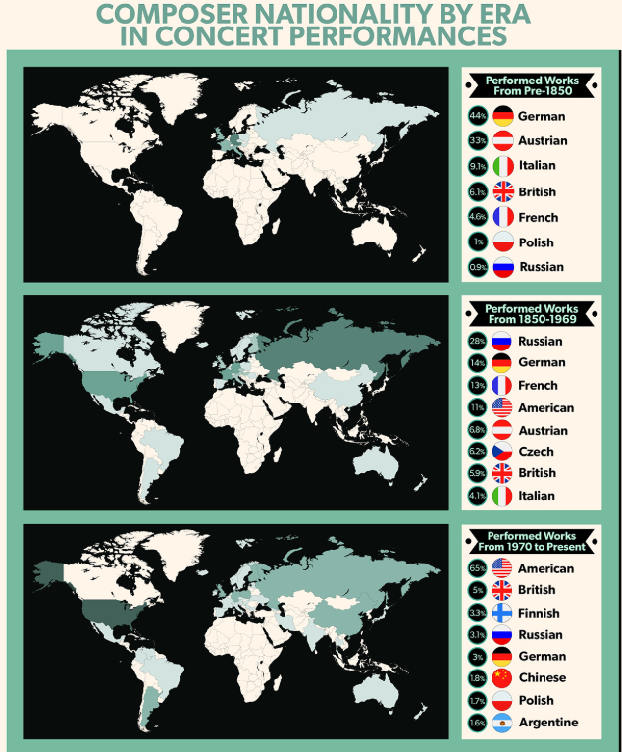
Comparison: 2016-2017 American Symphony Orchestra Season – Composer Nationality
1
Credit: https://www.bsomusic.org/stories/the-data-behind-the-2016-2017-orchestra-season/

Slide 7
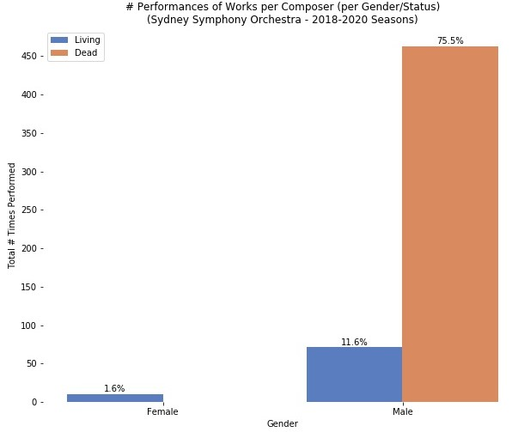
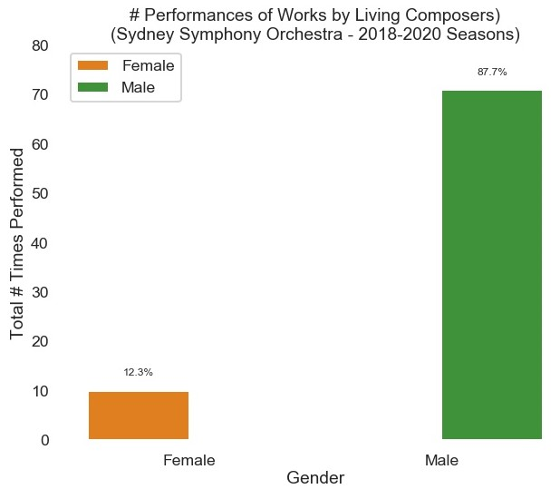
How does the Sydney Symphony Orchestra (SSO) compare?
1

Slide 8
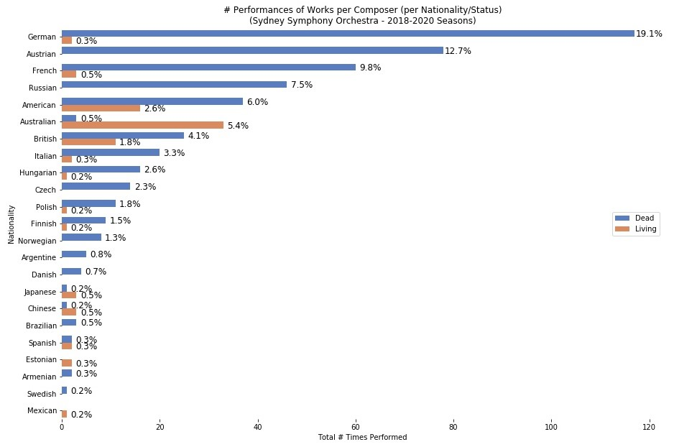
How does the Sydney Symphony Orchestra (SSO) compare?
1

Slide 9
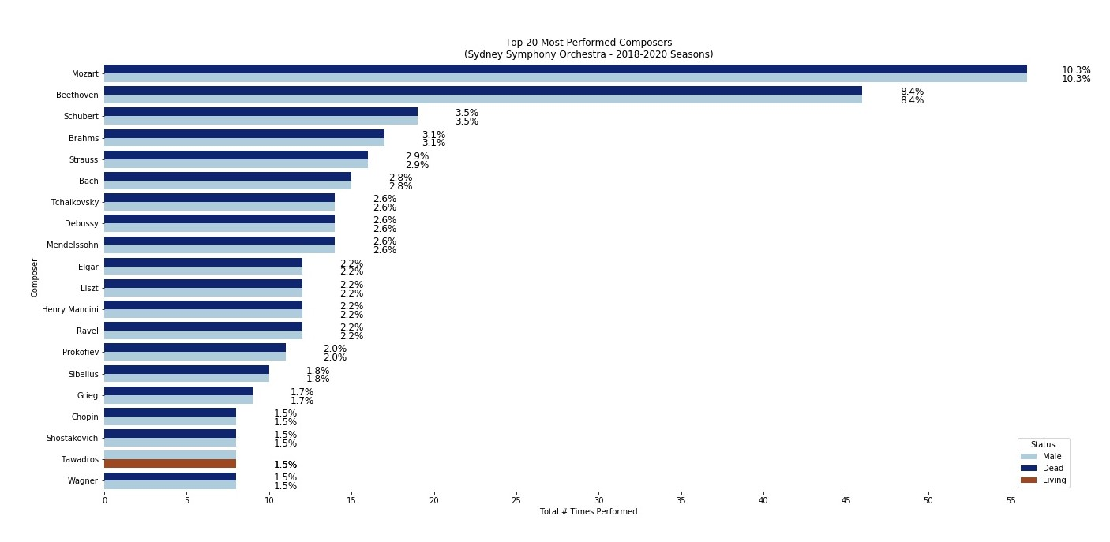
How does the Sydney Symphony Orchestra (SSO) compare?
1

Slide 10
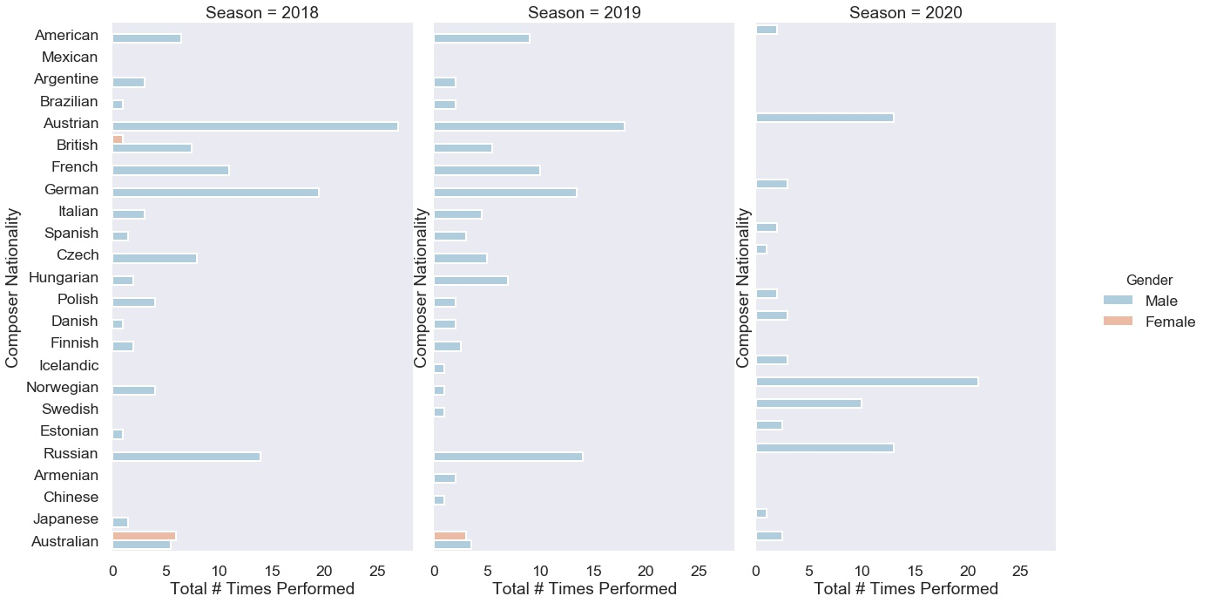
# Performed Works by Male/Female Composers by Season
1

Slide 11
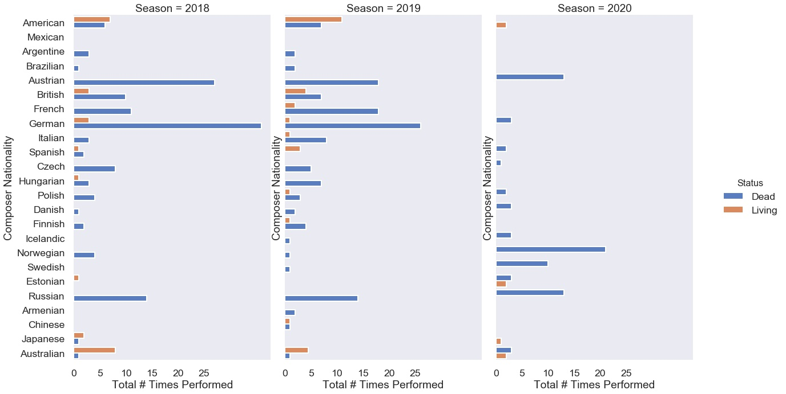
# Performed Works by Living/Dead Composers by Season
<number>

Slide 12
Conclusions
Female composer representation for the SSO doesn’t track much better in comparison to the 2018-2019 global symphony orchestra trend:
1.6% of all works performed over the 2018-2019 SSO seasons. No works by female composers have been scheduled for 2020.
12.3% of SSO works by living composers
However, 9 out of 10 female composers programmed in 2018-2019 were living and Australian
The top 20 most performed composers were largely male, dead and European.
<number>

